Slide 1
Conditional Flows
PrintNet T

Slide 2





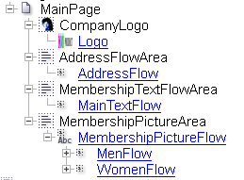
Conditional Flows – Purpose
  Multiple flows in one flow area.
  The selection of flow depends on a variable.
Notes:
The use of conditional flows is extensive (gender personalized letters, statements created according to customer city or country variability, advertisement following previously ordered products, etc.).

Slide 3



Conditional Flows – Example
Notes:
In this example, there are three conditional flows which depend on each individual customer’s data.
After the three flows, there is also one flow with manager signature and manager full name in it (also conditionally selected, as each customer will have a different manager).
This last flow can be scripted or selected by text (each manager is determined by an exact letter in the data file).

Slide 4

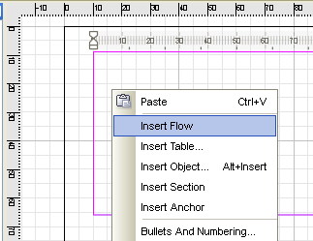
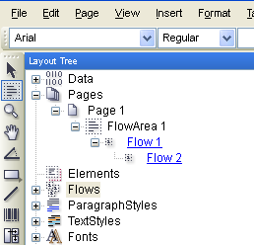
Nested Flows
Nested Flow:
  A ‘flow-within-a-flow’
  Right-click on flow area and select Insert Flow
  New flow node will appear ‘inside’ the original flow node
  Unlimited number of nested flows possible
Notes:
Flow is created automatically after you create a flow area, but it is also possible to insert another flow into the same flow area.
Right-click on a flow area in the Layout Page and select Insert Flow (Flow Area tool must be selected; the Insert menu from the Menu Bar can also be used). This will create a “flow within a flow”, otherwise called a nested flow (it appears under the original flow node in the Layout tree).
A user can create as many nested flows within a flow as they like.

Slide 5
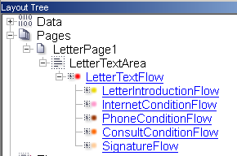
Conditional Flows
To set up conditional flow selection:
  Create a flow area; the first flow will be created automatically.
Insert a few nested flows inside the original flow.
Notice the flow icons. All of them are simple by default.
Notes:
Hint 1: click on View | Highlight Flows – flows will be marked with a color dot in the layout tree and also bordered with the same color in Layout
Hint 2: click on View | Highlight Selected Object – the selected object is marked with magenta color for better orientation in Layout

Slide 6
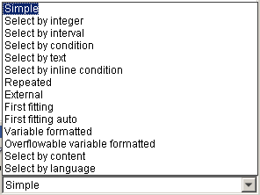
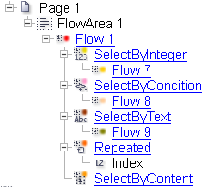

Conditional Flows
  For each nested flow:
  Click on its node in the Layout tree
  Change the type for each flow in Layout Properties (Select by)
  Flow type icons
  New flows created inside automatically
Notes:
Basic Types
Select by:
Integer – flows are selected in accordance with some numbers in the data file.
Condition – variable must be BOOLEAN type. Overflow is mostly used in this case.
Text – variable is String type and flows are selected by matching with some text (letter, word, etc.)
Inline condition – this is used for scripted conditions.
Repeated – content of data field is repeated in the flow.

Slide 7

Conditional Flows – Exercise I
Create a simple conditional flow that depends on a customer’s gender.
  Open ConditionalFlow1.wfd.
  Create one new flow area under the letter body.
  Change the flow type to Select by text
  Add two nested flows into the conditional one
  Set the Layout properties of the conditional flow (add new flow conditions, set the values, assign them to correct nested flows)
  Remember to set the variable! (CustGen)
  Adjust flows by adding to each of them suitable images for men and women
  Proof the job <F6>
  Make sure your flow area is big enough to display your flow content!
  Try working directly with the flow itself (double-click on flow node)
Notes:
Check ConditionalFlow1_done.wfd for the resolution.
CustGen – 1 = male; 2 = female…see Data Input.
Question: Why can’t we use “Select by condition” in this case?
Answer: CustGen value is 1 and 2 and we can’t transform it into boolean

Slide 8
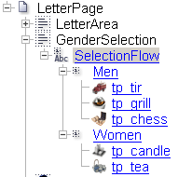
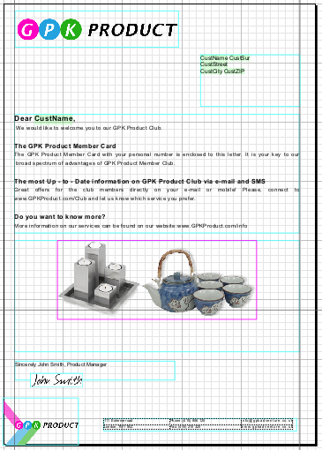
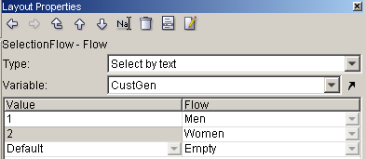
Conditional Flows – Exercise I
Notes:
ConditionalFlow1_done.wfd

Slide 9
Conditional Flows – Exercise II
Create conditional flows that depend on a customer’s services.
  Open ConditionalFlow2.wfd
  In Letter_TextFlow, create three flows selected by condition (Internet, Phone, Consult)
  Use FIIFServices.txt as text source; insert each part of the text into its proper flow (Internet, Phone, and Consult)
  Set Layout Properties for each flow, so that each respective flow will be displayed if the customer has that option; the flow should not be displayed if the customer does not have that option
  Proof the job <F6>
Notes:
Check ConditionalFlow2_done.wfd for the resolution.
The trainer can decide the initial level of this exercise. Trainees can use the predefined layout or make the workflow from scratch.
Beware of the last flow – the manager signature is scripted (check the finished exercise .WFD). The trainees do not need to do this part – PrintNet T Basic training should be done with no scripting.

Slide 10
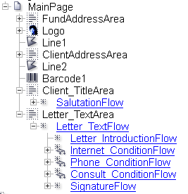
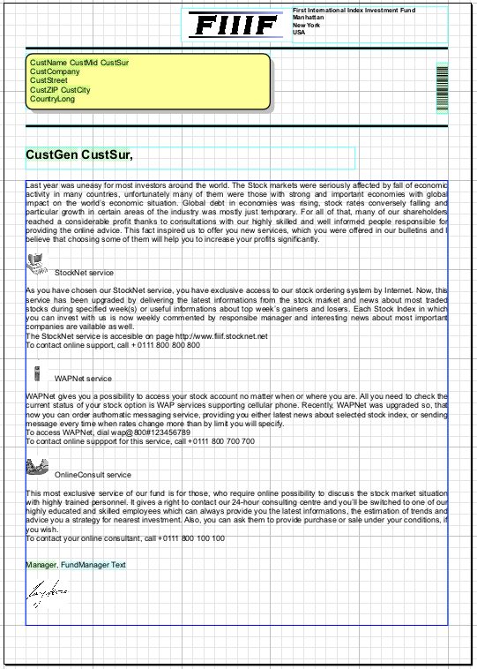
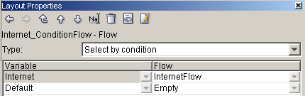
Conditional Flows – Exercise II
Notes:
ConditionalFlow2_done.wfd

Slide 11

Conditional Flows – Summary
In this presentation we have learned:
  How to:
    Create nested flows
    Change the type of flow from single to conditional
    Set the correct value to each flow
    Use conditional flows in a simple Layout

Slide 12

Conditional Flows – Discussion
Is it possible to use “Select by condition” for every type of variable?
Can more than one nested flow be used?
When working with a conditional flow, is it necessary to set the variable in Layout Properties?
Notes:
1. Is it possible to use “Select by condition” for every type of variable?
No, the variable must be BOOLEAN type. Otherwise we have to use “Select by text”, “Select by integer”, etc.
2. Can more than one nested flow be used?
Yes, we can add as many nested flows to one flow as we want
3. When working with a conditional flow, is it necessary to set the variable in Layout Properties?
Yes, because otherwise we will get empty page or Error message during proof.

Slide 13

Thank You.
Do You Have Any Questions?

